Slide 1

Introduction to Operating Systems CS/COE 1550
Fall 2021
Sherif Khattab
ksm73@pitt.edu
(Some slides are from Silberschatz, Galvin and Gagne ©2013)

Slide 2
Announcements
Lab 0 due next Friday (not graded)
Homework 1 will be posted this Friday
Recitations start this week
VS Code Tutorial on Canvas
Draft Slides on Canvas

Slide 3
Muddiest Points
Does every program on the computer interact with the hardware exclusively through OS system calls or are there exceptions?
Relation between interrupts and kernel/user mode
Does event driven programming rely on system interrupts? This sounds very similar to the pub/sub method.
how os check kernel mode or user mode
The difference between system call and function call, and the dual-mode change (can't hear clearly on Zoom)
multi-threaded programs sound complicated
Is the Kernel essentially the program that runs the OS? (ie. what is the difference between OS & kernel)
How interrupts use system calls to interact with the OS
Interrupts are little confusing, specifically what counts as an interrupt and how the computer reacts to them.
How does the computer know an interruption has been triggered in the first place, like how to do the sensors work?
How is the interrupt vector called/acessed?
interrupt service routine vs interrupt vector table
code segment flags. why are they necessary?
I think you went reverse over the points on the “What does OS do” slide and it threw me off while I was trying to take notes
How the interrupt registers are protected (and thus how kernel access is protected)
interrupts: do they work similar to event listeners in web development?
Why should we use C in OS designing
GDB

Slide 4
What happens on a hardware interrupt?
6
1
4
7
5
9
2
3
8

Slide 5
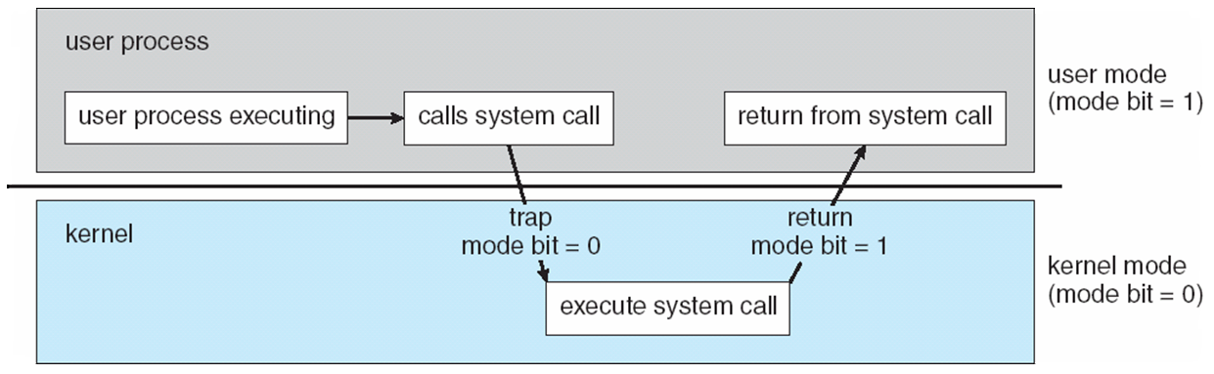
Transition from User to Kernel Mode

Slide 6
System Calls
Programming interface to the services provided by the OS
Typically written in a high-level language (C or C++)
Mostly accessed by programs via a high-level Application Programming Interface (API) rather than direct system call use
Three most common APIs are Win32 API for Windows, POSIX API for POSIX-based systems (including virtually all versions of UNIX, Linux, and Mac OS X), and Java API for the Java virtual machine (JVM)

Slide 7
System Call Implementation
Typically, a number associated with each system call
System-call interface maintains a table indexed according to these numbers
The system call interface invokes the intended system call in OS kernel and returns status of the system call and any return values
The caller need know nothing about how the system call is implemented

Slide 8
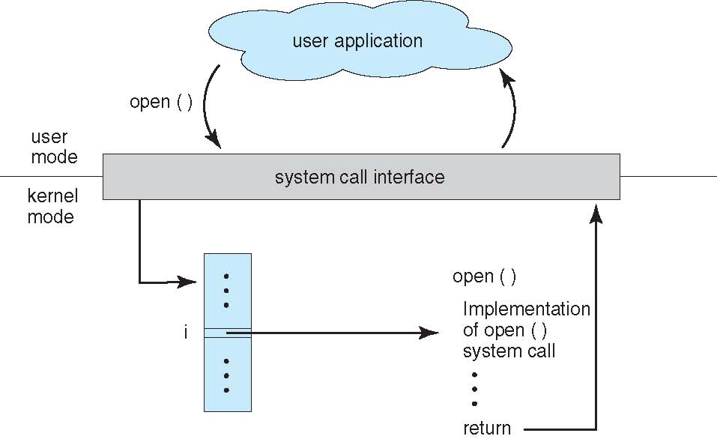
API – System Call – OS Relationship

Slide 9
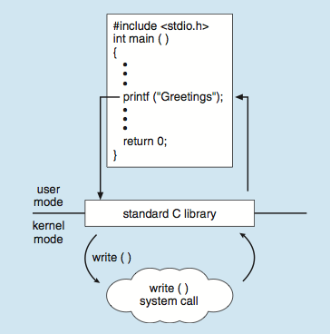
Standard C Library Example
C program invoking printf() library call, which calls write() system call

Slide 10
What happens on a syscall?
2
1
7
6
12
1
eax <-- 1
10
3
int 64
5
4
11
8
9

Slide 11
System Call Parameter Passing
Three general methods used to pass parameters to the OS
Simplest: pass the parameters in registers
In some cases, may be more parameters than registers
Parameters stored in a block, or table, in memory, and address of block passed as a parameter in a register
This approach taken by Linux and Solaris
Parameters placed, or pushed, onto the stack by the program and popped off the stack by the operating system
Block and stack methods do not limit the number or length of parameters being passed

Slide 12
How to add a system call to an OS?

Slide 13
Xv6 Code Walkthrough
IDT table initialization
Syscall table

